Slide 1
Forward Kinematics
Design Problem 1

Slide 2
Agenda
Problem Background
Learning Objectives
Live Coding!

Slide 3
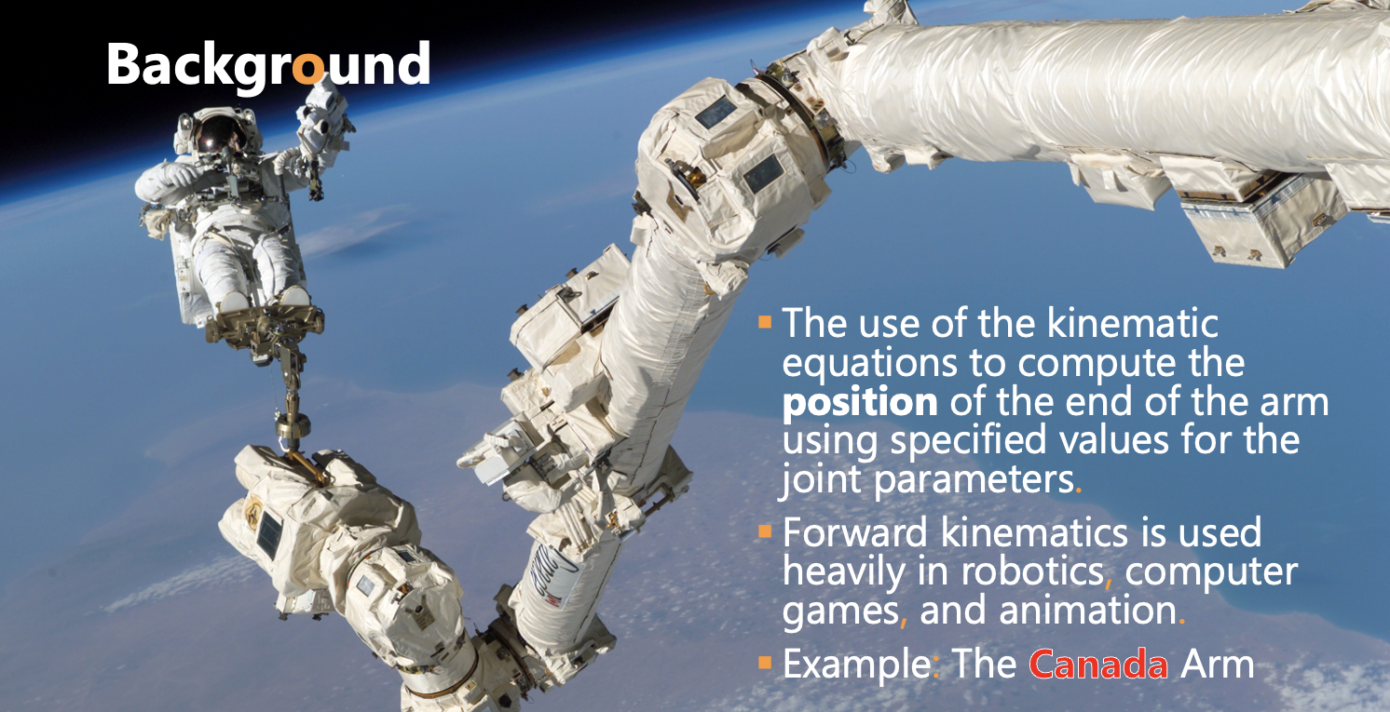

Slide 4
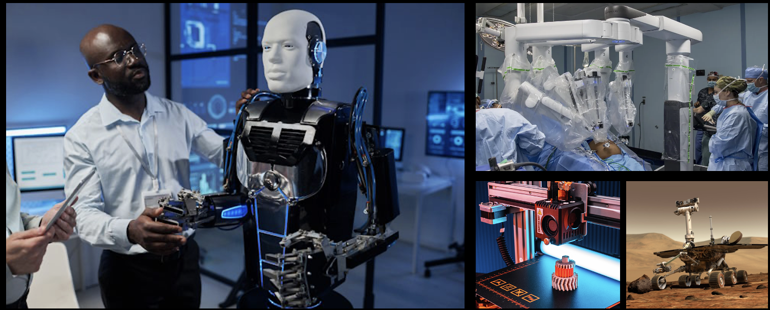
Other Cool Examples:
Humanoid and Industrial Robots, Animations and Gaming, 3D printing, …

Slide 5
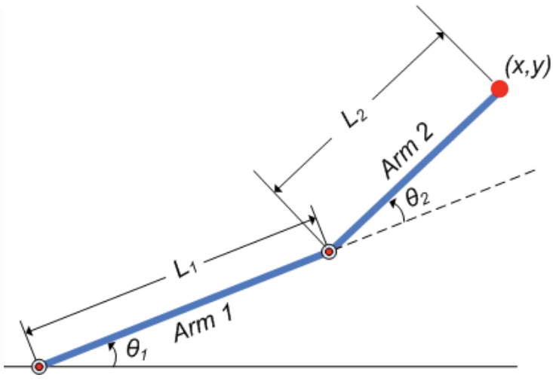
Background
Goal: Create a program that finds the x- and y- position of the effector arm (i.e. the end of Arm #2).
Will rely on trigonometry to find the positions.

Slide 6
Learning Objectives
Practice with user input.
Learn to define and use custom functions.
Practice with built-in libraries.

Slide 7
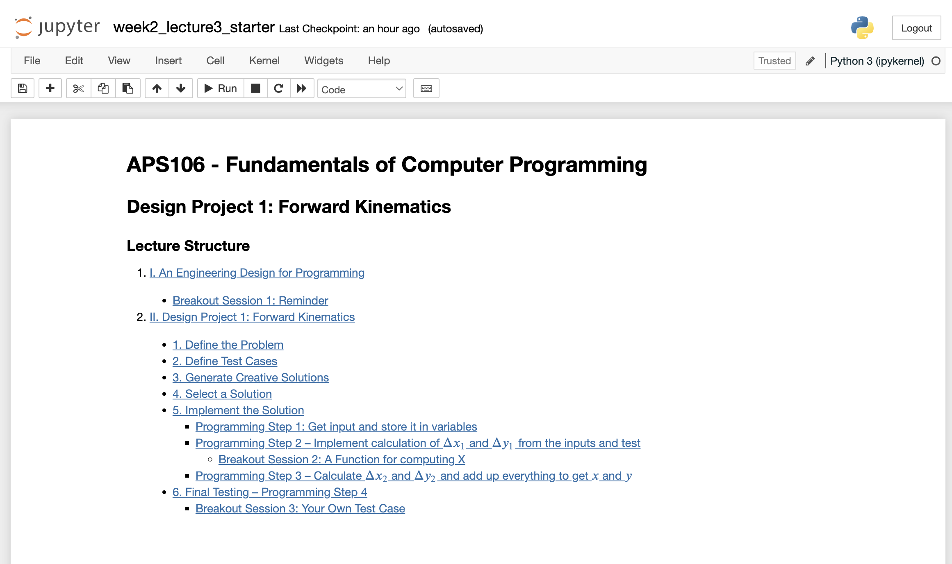
Forward Kinematics
Design Problem 1
Let’s review the notebook now!

